Slide 1
Software Testing

Slide 2
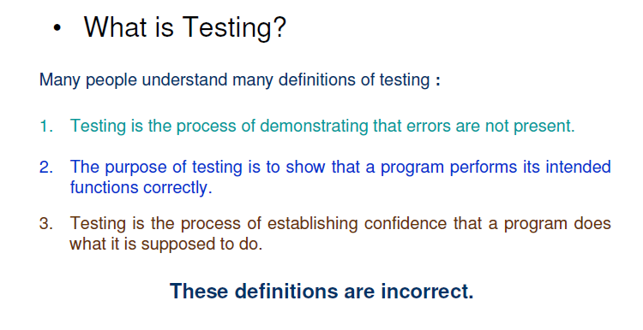

Slide 3
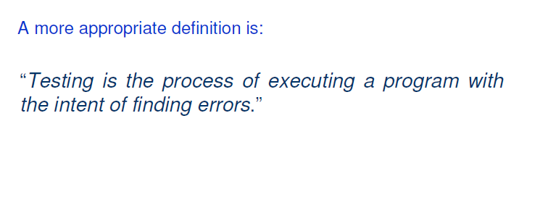
Testing strategy includes-
Planning
Designing of test cases
Interpretation of the outcome
Collection and management of data

Slide 4
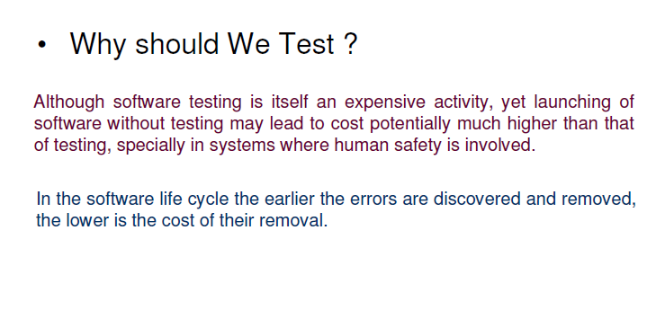
Notes:
Even more important in So-called life critical systems

Slide 5
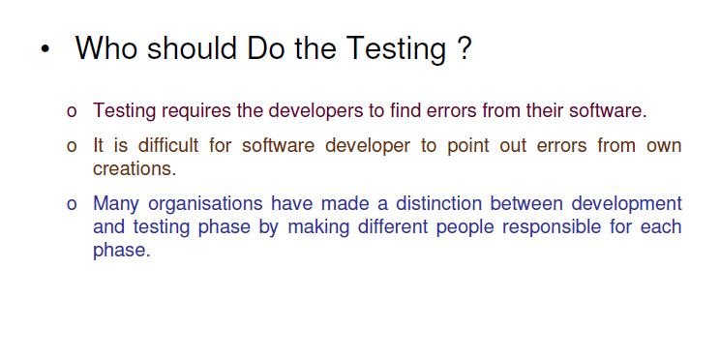

Slide 6
What should we test?
Test the program’s response to every possible input.
First way, to test for every possible valid and invalid input and their corresponding outputs.
Second way is to execute all possible paths of the program.

Slide 7
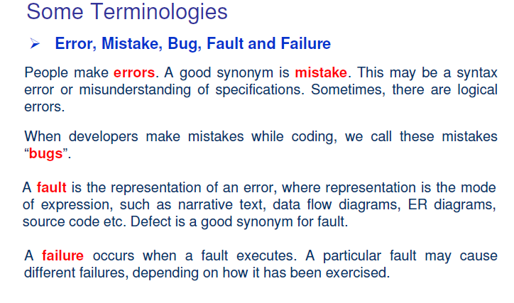

Slide 8
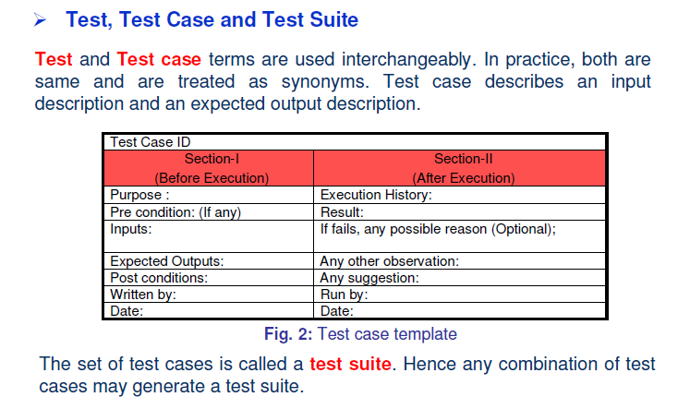

Slide 9
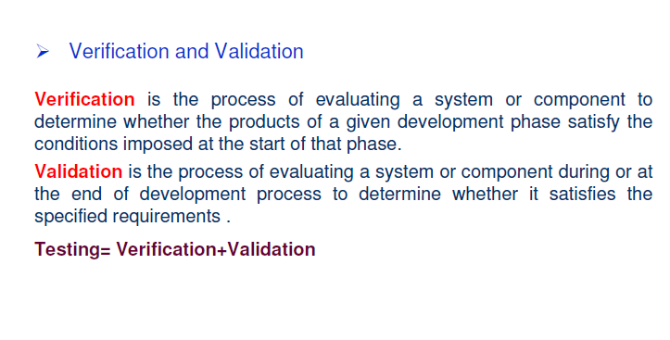

Slide 10
Alpha, Beta & Acceptance Testing
Alpha test: It is conducted at the developer’s site by the customer.
The software is used in a natural setting with the developer “looking over the shoulder” of the user and recording errors and usage problems.
It is conducted in a controlled environment.

Slide 11
Beta test: It is conducted at one or more customer sites by the end-user of the software.
Unlike alpha testing, the developer is generally not present.
A “Live” application of the software in an environment that cannot be controlled by the developer.
The customer records all problems(real or imagined) and reports to the developer at regular intervals.
Software engineers make modifications according to the problems reported by the customer and then prepare for release of the product .

Slide 12
Acceptance Testing: A formal product evaluation performed by a customer as a condition of purchase.
Formal testing of a new computer system by prospective users.
Carried out to determine whether the software satisfies its acceptance criteria and should be accepted by the customer.
It is one of the final stages of a software project and will often be performed before a new system is accepted by the customer.

Slide 13
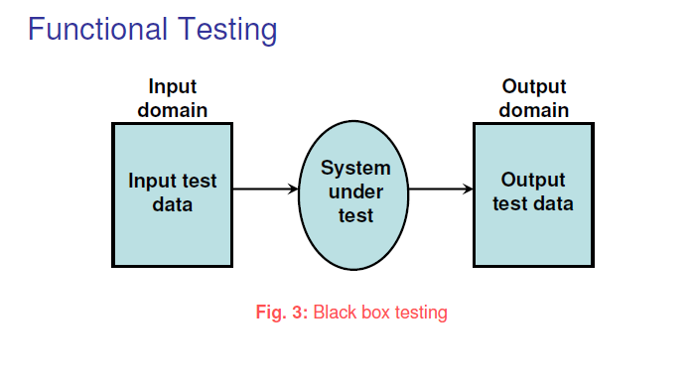
Notes:
The poorest methodology is random input testing. (involves random selection of subset of all input values)

Slide 14
Functional testing refers to testing, which involves only observations of the output for certain input values.
There is no attempt to analyze the code which produces the output.
We ignore the internal structure of the code.
Therefore, also referred to as black box testing.

Slide 15
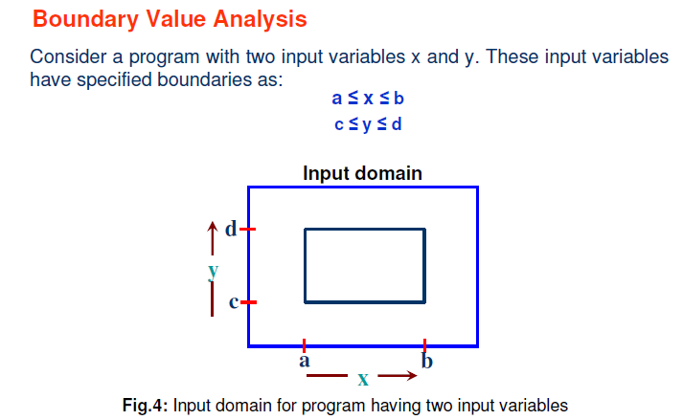

Slide 16
The basic idea is to use input variable values at their minimum, just above minimum, a nominal value, just below their maximum, and at their maximum.
An assumption of reliability theory known as “single fault” assumption is used.
This says that failures are rarely the result of the simultaneous occurrence of two (or more) faults.
Thus, boundary value analysis test cases are obtained by holding the values of all but one variable at their nominal values and letting that variable assume its extreme values.

Slide 17
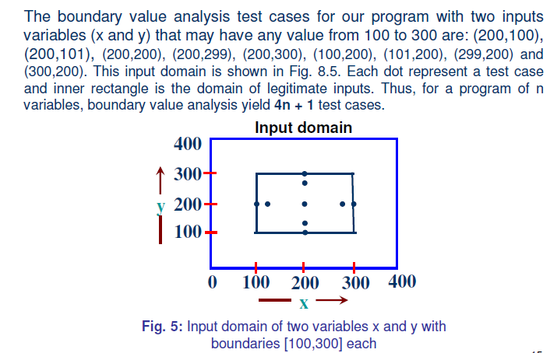

Slide 18
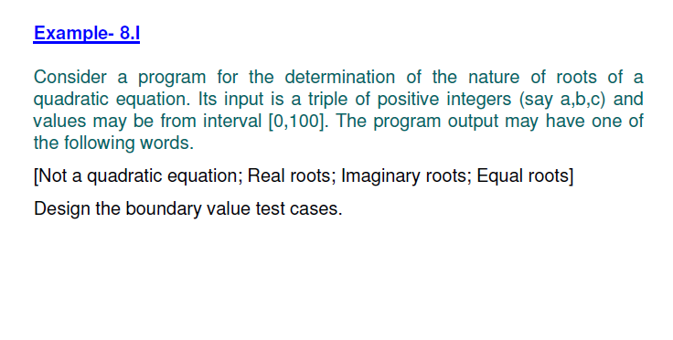
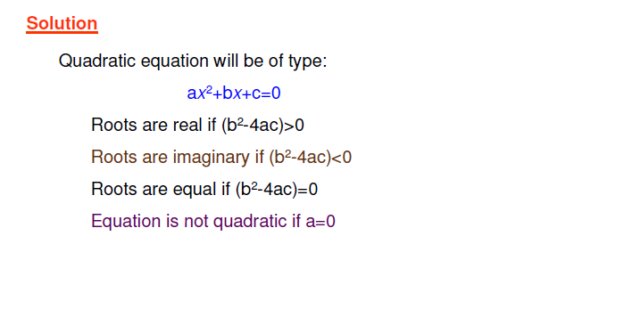

Slide 19
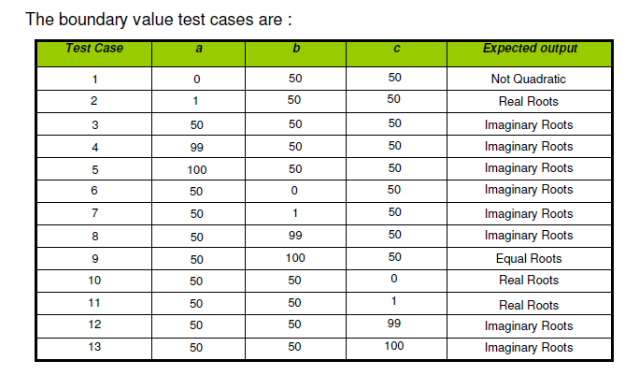

Slide 20
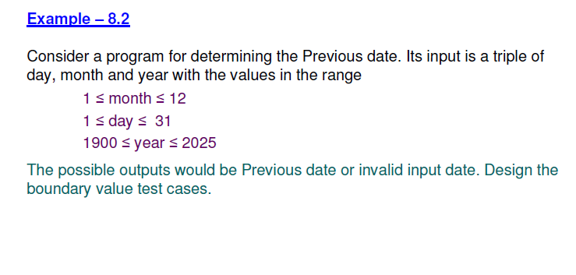

Slide 21
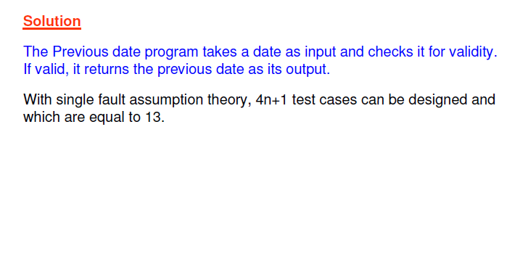

Slide 22
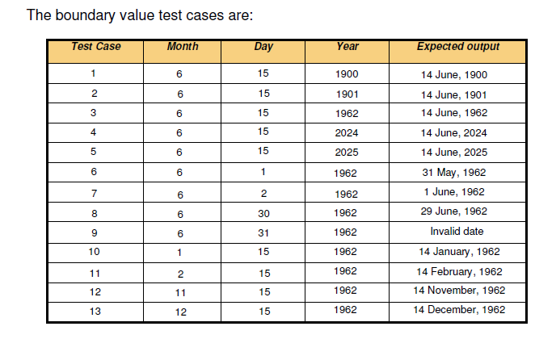

Slide 23
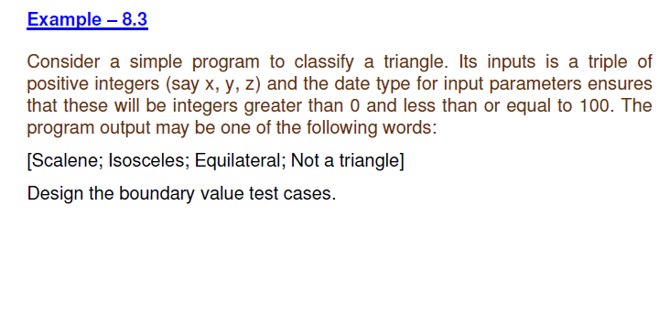

Slide 24
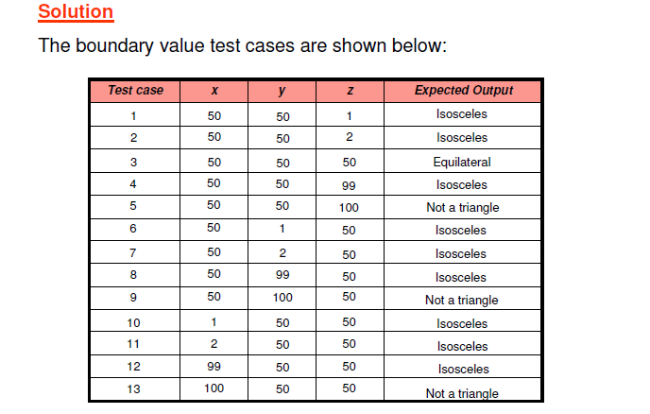

Slide 25
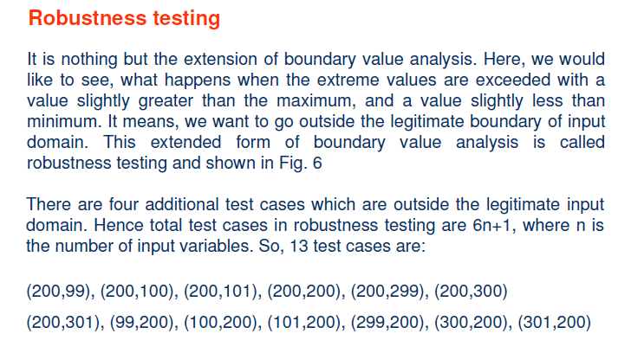

Slide 26
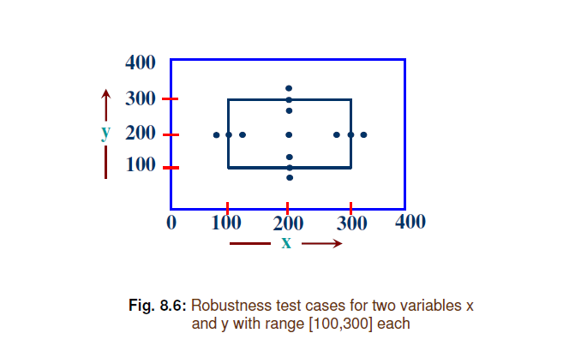

Slide 27
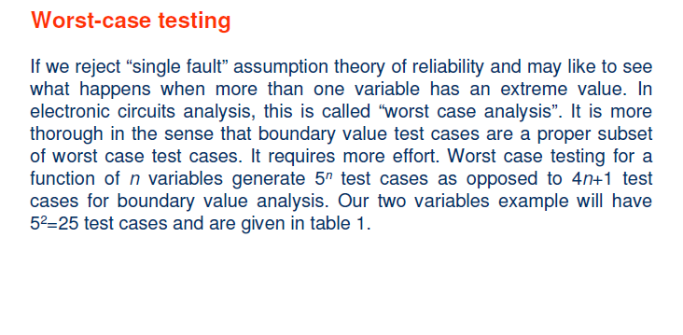

Slide 28
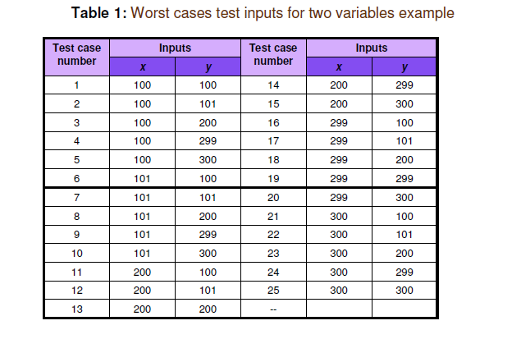

Slide 29
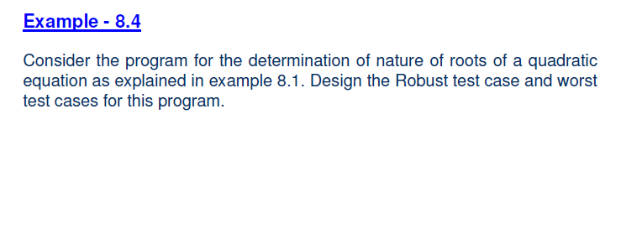
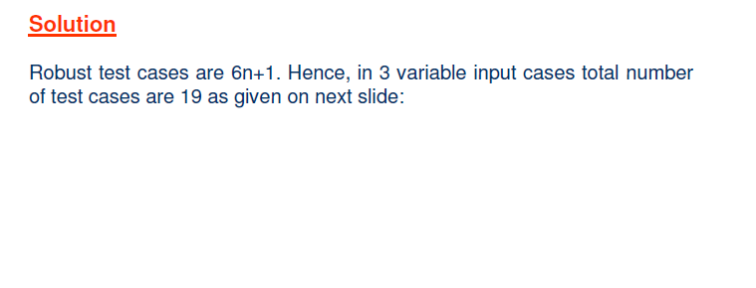

Slide 30
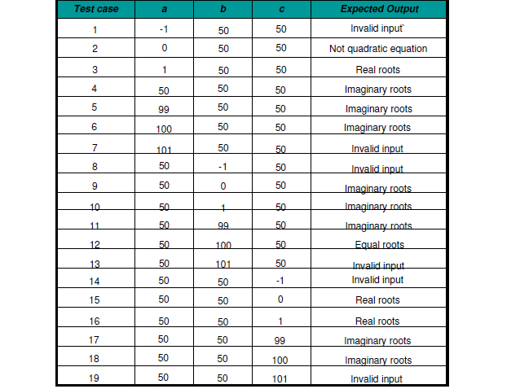
Fig: Robust test cases

Slide 31
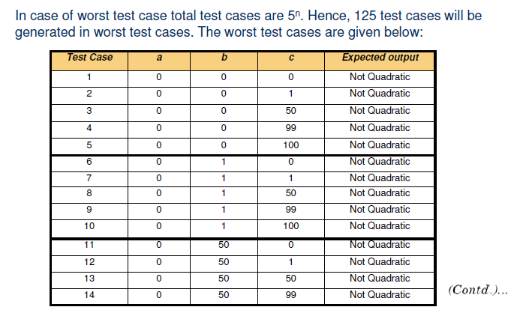

Slide 32
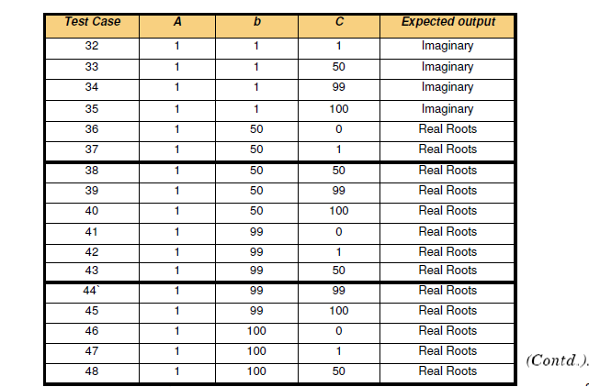
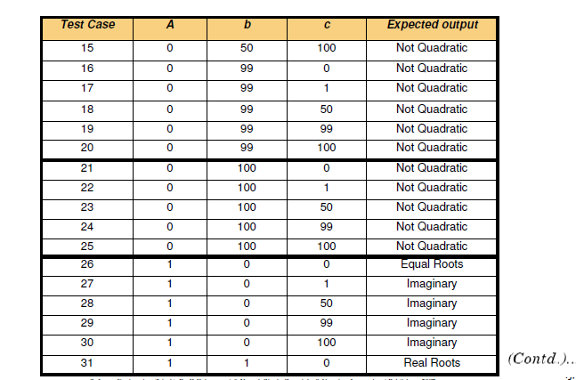

Slide 33
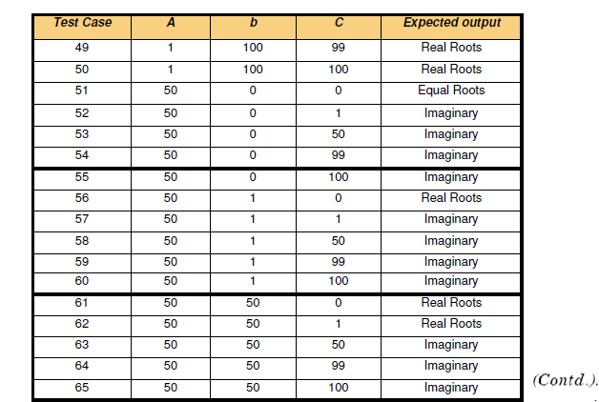

Slide 34
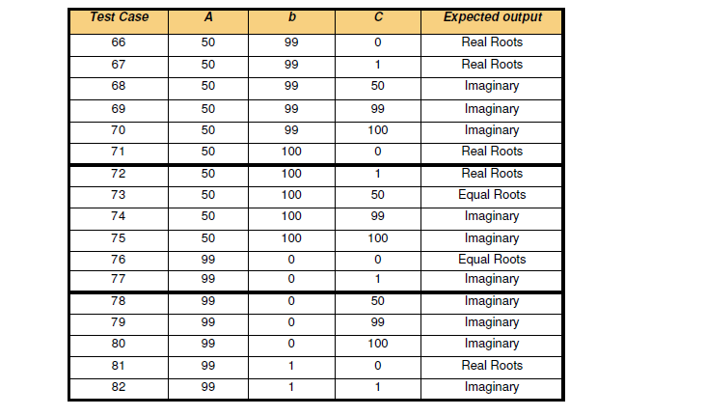

Slide 35
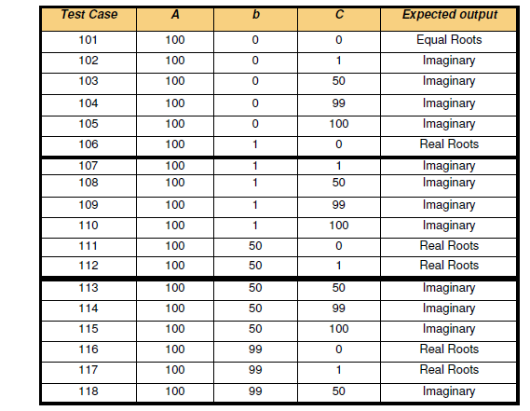
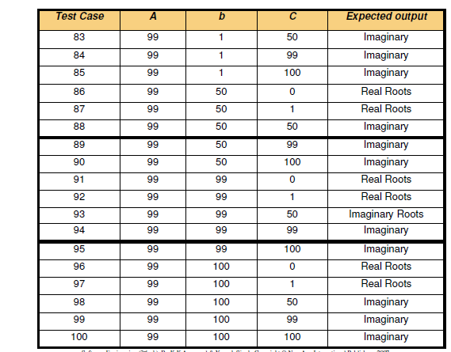

Slide 36
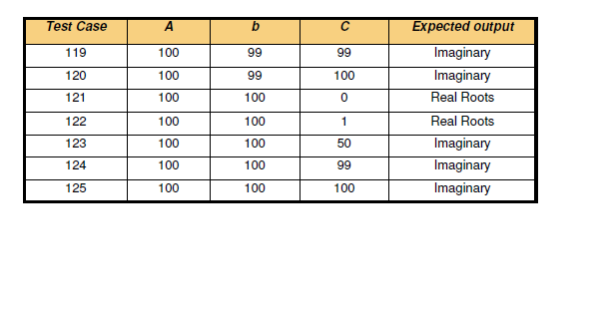

Slide 37
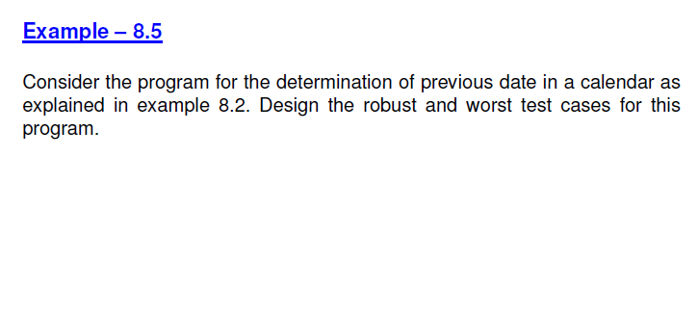
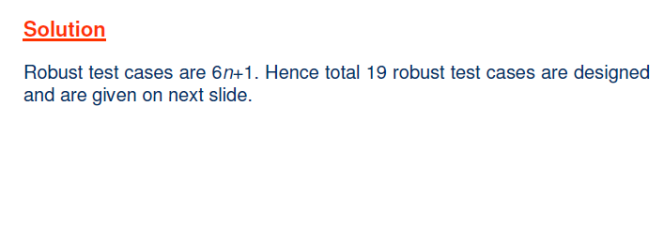

Slide 38
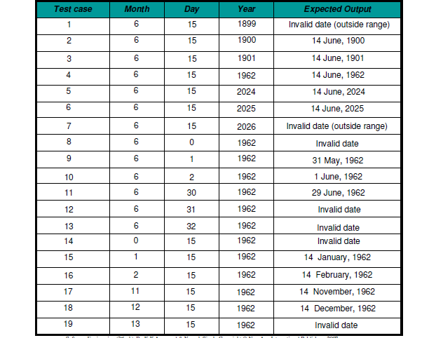

Slide 39
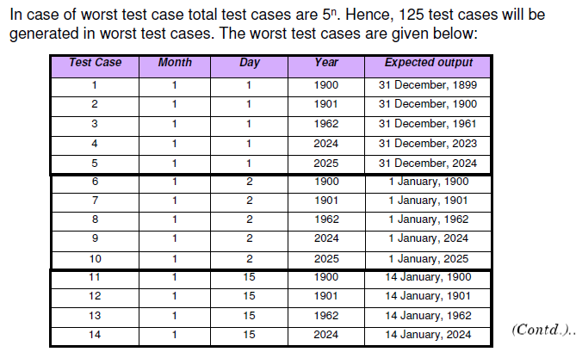

Slide 40
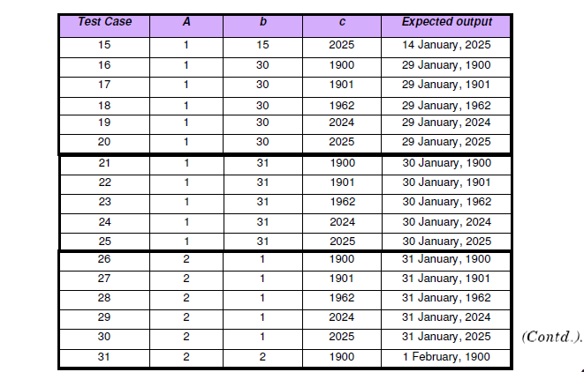

Slide 41
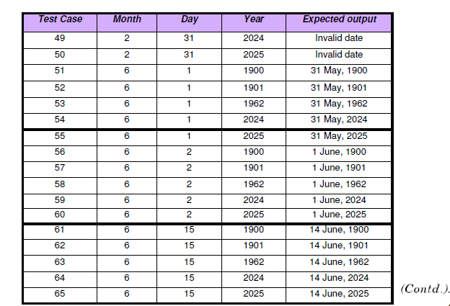
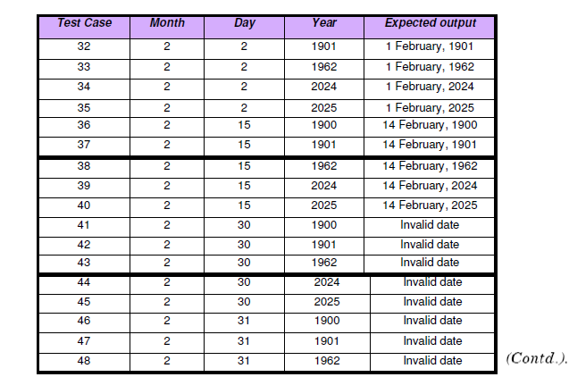

Slide 42
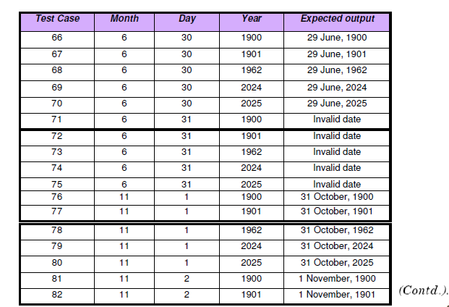

Slide 43
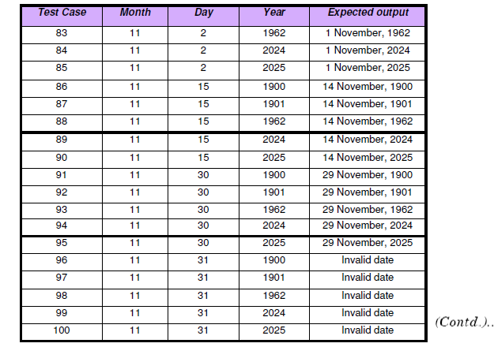

Slide 44
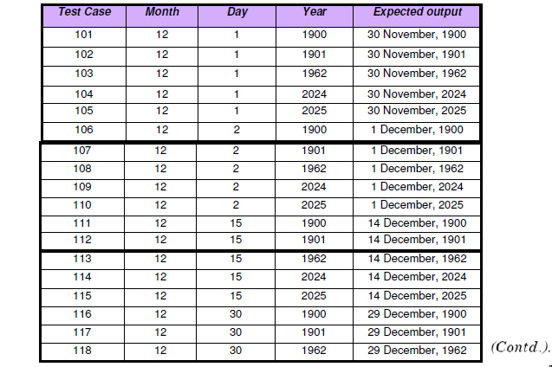

Slide 45
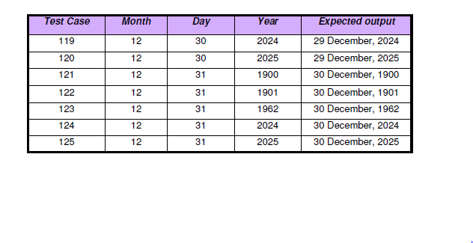

Slide 46
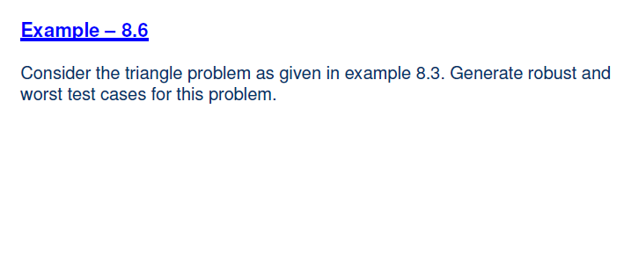
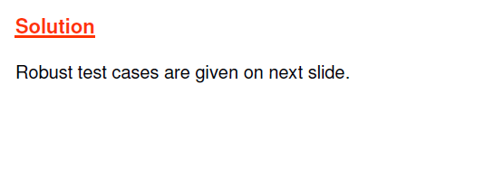

Slide 47
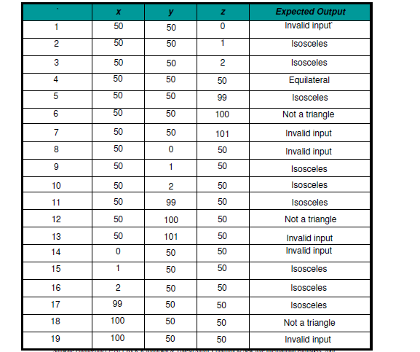

Slide 48
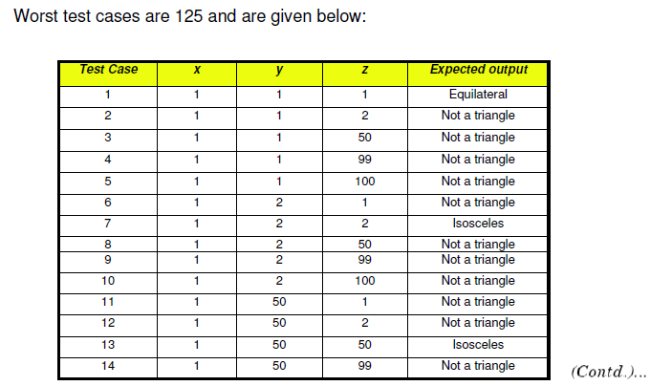

Slide 49
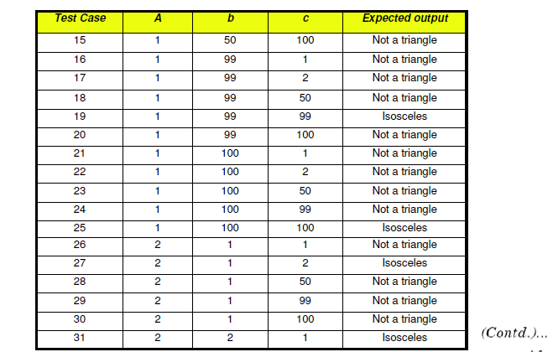

Slide 50
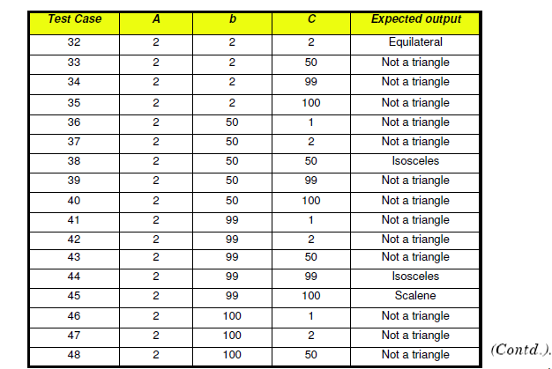

Slide 51


Slide 52


Slide 53


Slide 54


Slide 55


Slide 56


Slide 57


Slide 58



Slide 59


Slide 60


Slide 61



Slide 62


Slide 63


Slide 64



Slide 65


Slide 66


Slide 67


Slide 68


Slide 69



Slide 70


Slide 71


Slide 72


Slide 73



Slide 74
For this condition, we can create 8 different test cases and ensure complete coverage based on the above table.
Upload a photo with format '.jpg', size less than 32kb and resolution 137*177 and click on upload. Expected result is “Photo should upload successfully”
Upload a photo with format '.jpg', size less than 32kb and resolution not 137*177 and click on upload. Expected result is Error message “resolution mismatch should be displayed”
Upload a photo with format '.jpg', size more than 32kb and resolution 137*177 and click on upload. Expected result is Error message “size mismatch should be displayed”
Upload a photo with format '.jpg', size less than 32kb and resolution not 137*177 and click on upload. Expected result is Error message “size and resolution mismatch should be displayed”

Slide 75
5. Upload a photo with format other than '.jpg', size less than 32kb and resolution 137*177 and click on upload. Expected result is “Error message for format mismatch should be displayed”
6. Upload a photo with format other than '.jpg', size less than 32kb and resolution not 137*177 and click on upload. Expected result is “Error message format and resolution mismatch should be displayed”
7. Upload a photo with format other than '.jpg', size more than 32kb and resolution 137*177 and click on upload. Expected result is “Error message for format and size mismatch should be displayed”
8. Upload a photo with format other than '.jpg', size more than 32kb and resolution not 137*177 and click on upload. Expected result is “Error message for format, size and resolution mismatch should be displayed”

Slide 76
Structural Testing:
It is a complementary approach to functional testing and is also called white box testing.
It permits us to examine the internal structure of the program.
In this strategy, we derive test cases from an examination of the program’s logic.
For eg., if the first statement of the code is “if(x<=100)”, then we may try testing the program with a test case of 100.

Slide 77
It may find those errors which have been missed by functional testing.
If we want to look into the program, examine the code and watch it as it runs, then the activity is dynamic and therefore called dynamic white testing box testing.
If we want to test the program without running it; meaning thereby examining and reviewing it; then it is called static white box testing.

Slide 78
Pick enough paths to assure that every source statement is executed at least once.
It is mostly applicable to new software for module or unit testing.
It requires complete knowledge of the program’s structure and used by developers to unit test their own code.
The effectiveness of path testing rapidly deteriorates as the size of the software under test increases. It is rarely, if ever, used for system testing.
Notes:
Pick enough paths to assure that every source statement is executed at least once.
It requires complete knowledge of the program’s structure and used by developers to unit test their own code.
The effectiveness of path testing rapidly deteriorates as the size of the software under test increases. It is rarely, if ever, used for system testing.

Slide 79


Slide 80
Flow Graph:
The control of a program can be analyzed using graphical representation known as flow graph.
The flow graph is a directed graph in which modes are either entire statements or fragments of a statement, and edges represents flow of control.
If I and j are nodes in the program graph, there is an edge from node i to node j if the statement(fragment) corresponding to node j can be executed immediately after the statement(fragment) corresponding to node i.

Slide 81


Slide 82
Fibonacci series C program using a for loop
/* Fibonacci series program in C language */
#include <stdio.h>
int main()
{
int n, first = 0, second = 1, next, c;
printf("Enter the number of terms\n");
scanf("%d", &n);
printf("First %d terms of Fibonacci series are:\n", n);
for (c = 0; c < n; c++)
{
if (c <= 1)
next = c;
else
{
next = first + second;
first = second;
second = next;
}
printf("%d\n", next);
}
return 0;
}

Slide 83


Slide 84


Slide 85


Slide 86


Slide 87


Slide 88


Fig: Flow Graph of previous data problem

Slide 89
Decision to Decision(DD) path graph:
We generate the DD path graph from the flow graph.
Here, we concentrate only on decision nodes.
The nodes of flow graph, which are in a sequence are combined together in a single node.

Slide 90


Slide 91


Slide 92


Slide 93


Slide 94


Fig: DD path graph of previous date problem

Slide 95
Independent paths:
The DD path graph is used to find independent paths.
We are interested to execute all independent paths at least one during path testing.
An independent path is any path through the DD path graph that introduces at least one new set of processing statements or new conditions.
Therefore, an independent path must move along at least one edge that has not been traversed before the path is defined.

Slide 96
The independent paths are used to ensure that:
Every statement in the program has been executed at least once.
Every branch has been exercised for true and false conditions.
In practice, it is reasonable to make DD path graphs upto 100 source lines. Beyond that, we should go for a standard tool.

Slide 97


Slide 98


Slide 99


Slide 100


Slide 101


Slide 102


Slide 103


Slide 104


Slide 105


Slide 106


Slide 107


Slide 108


Slide 109


Slide 110


Slide 111


Slide 112
Cyclomatic Complexity:
It is also known as structural complexity because it gives internal view of the code.
The approach is used to find the number of independent paths through a program.
This provides the upper bound for the number of tests that must be conducted to ensure that all statements have been executed at least once and every condition has been executed on its false and true side.

Slide 113


Slide 114


Slide 115
The value of the cyclomatic complexity can be calculated as
V(G)= e-n+2P
Where, e is the number of edges,
n is the number of vertices and
p is the number of connected components.

Slide 116


Slide 117


Slide 118


Slide 119



Slide 120



Slide 121



Slide 122
Mutation Testing:
Mutation Testing is a type of software testing where we mutate (change) certain statements in the source code and check if the test cases are able to find the errors.
It is a type of White Box Testing which is mainly used for Unit Testing.
The changes in mutant program are kept extremely small, so it does not affect the overall objective of the program.

Slide 123

The changes in mutant program are kept extremely small, so it does not affect the overall objective of the program.

Slide 124
Following are the steps to execute mutation testing:
Step 1: Faults are introduced into the source code of the program by creating many versions called mutants. Each mutant should contain a single fault, and the goal is to cause the mutant version to fail which demonstrates the effectiveness of the test cases.
Step 2: Test cases are applied to the original program and also to the mutant program. A test Case should be adequate, and it is tweaked to detect faults in a program.
Step 3: Compare the results of original and mutant program.
Step 4: If the original program and mutant programs generate the different output, then that the mutant is killed by the test case. Hence the test case is good enough to detect the change between the original and the mutant program.
Step 5: If the original program and mutant program generate same output, Mutant is kept alive. In such cases, more effective test cases need to be created that kill all mutants.

Slide 125
How to Create Mutant Programs?
A mutation is nothing but a single syntactic change that is made to the program statement. Each mutant program should differ from the original program by one mutation.
Original Program
if (x>y) Print "Hello" Else Print "Hi“
Mutant Program
If(x<y) Print "Hello" Else Print "Hi"

Slide 126


Slide 127
Criteria for completion of testing:
"When are we done testing—how do we know that we've tested enough?“
No definitive answer to this question
A few pragmatic responses
"You're never done testing, the burden simply shifts from you (the software engineer) to your customer.“
"You're done testing when you run out of time or you run out of money."

Slide 128
Musa and Ackerman [MUS89] suggest a response that is based on statistical criteria:
"No, we cannot be absolutely certain that the software will never fail, but relative to a theoretically sound and experimentally validated statistical model, we have done sufficient testing to say with 95 percent confidence that the probability of 1000 CPU hours of failure free operation in a probabilistically defined environment is at least 0.995."

Slide 129


Slide 130

Using statistical modeling and software reliability theory, models of software failures (uncovered during testing) as a function of execution time can be developed[MUS89].
A version of the failure model, called a logarithmic Poisson execution-time model, takes the form

Slide 131
The instantaneous failure intensity, l(t) can be derived by taking the derivative of f(t)
If the actual data gathered during testing and the logarithmic Poisson execution time model are reasonably close to one another over a number of data points, the model can be used to predict total testing time required to achieve an acceptably low failure intensity.

Slide 132


Slide 133
Errors located during testing may fall into several categories:
Those that require immediate attention are usually of a nature that they crash the software under consideration, and testing cannot continue during the immediate testing schedule.
Some errors need to be corrected before testing is complete but can be ignored during the immediate testing schedule.
The importance of removing an error is proportional to its severity, the frequency with which it occurs, and the degree to which the customer is aware of it.

Slide 134
There are errors that may be acceptable to the user when compared to the cost of correcting them at the moment,; these will be held until some future release date or until the customer becomes concerned to request a change.
Finally, there are errors, usually non-reproducible, for which insufficient evidence exists to evaluate them.
They are flagged for ongoing consideration until they become more tractable.

Slide 135
Other activities that are carried out along with testing:
Test documentation
Product modification
Discussions with the customer to schedule installation
Preparation of installation
Trading material
Notes:
When the product has finally been released by the quality assurance group at the end of testing, we want to move immediately into the installation portion of product delivery.

Slide 136

Notes:
It Is the process of taking a module and running it in isolation from the rest of the software product by using prepared test cases and comparing the actual results with the results predicted by the specifications and design of the module.

Slide 137
How do we run a module without anything to call it, to be called by it or, possibly, to output intermediate values obtained during execution?
Stubs: Stubs serve to replace modules that are subordinate (called by) the component to be tested.
Driver: It is nothing more than a "main program" that accepts test case data, passes such data to the component (to be tested), and prints relevant results
Notes:
Drivers and stubs represent overhead.
If drivers and stubs are kept simple, actual overhead is relatively
low. Unfortunately, many components cannot be adequately unit tested with "simple"
overhead software. In such cases, complete testing can be postponed until the
integration test step (where drivers or stubs are also used).

Slide 138


Slide 139
Integration Testing:
Integration testing is a systematic technique for constructing the program structure while at the same time conducting tests to uncover errors associated with interfacing.
The objective is to take unit tested components and build a program structure that has been dictated by design.

Slide 140
Why is integration testing required?
Data can be lost across an interface;
one module can have an inadvertent, adverse affect on another;
subfunctions, when combined, may not produce the desired major function;
individually acceptable imprecision may be magnified to unacceptable levels; and so on….
Incremental integration is the antithesis of the big bang approach.

Slide 141
Classical integration strategies:
Top down integration
Bottom up integration
Notes:
Most of this concern is driven by the need to mix module testing into integration, because of a lack of test harnesses.

Slide 142

Top down Approach:
Depth first integration
Breadth first integration

Slide 143
The integration process is performed in a series of five steps:
1. The main control module is used as a test driver and stubs are substituted for all components directly subordinate to the main control module.
2. Depending on the integration approach selected (i.e., depth or breadth first), subordinate stubs are replaced one at a time with actual components.
3. Tests are conducted as each component is integrated.
4. On completion of each set of tests, another stub is replaced with the real component.
5. Regression testing may be conducted to ensure that new errors have not been introduced.

Slide 144
Bottom-up approach:
Bottom-up integration testing, as its name implies, begins construction and testing with atomic modules (i.e., components at the lowest levels in the program structure).
Because components are integrated from the bottom up, processing required for components subordinate to a given level is always available and the need for stubs is eliminated.

Slide 145


Slide 146
A bottom-up integration strategy may be implemented with the following steps:
1. Low-level components are combined into clusters (sometimes called builds)that perform a specific software subfunction.
2. A driver (a control program for testing) is written to coordinate test case input and output.
3. The cluster is tested.
4. Drivers are removed and clusters are combined moving upward in the program structure.

Slide 147
Regression Testing:
In the context of an integration test strategy, regression testing is the re-execution of some subset of tests that have already been conducted to ensure that changes have not propagated unintended side effects.
Regression testing is the activity that helps to ensure that changes (due to testing or for other reasons) do not introduce unintended behavior or additional errors.

Slide 148
The regression test suite (the subset of tests to be executed) contains three different classes of test cases:
A representative sample of tests that will exercise all software functions.
Additional tests that focus on software functions that are likely to be affected by the change.
Tests that focus on the software components that have been changed.

Slide 149
Integration Test Documentation:
An overall plan for integration of the software and a description of specific tests are documented in a Test Specification.
Testing is divided into phases and builds that address specific functional and behavioral characteristics of the software.

Slide 150
For example, integration testing for a CAD system might be divided into the following test phases:
User interaction (command selection, drawing creation, display representation, error processing and representation).
• Data manipulation and analysis (symbol creation, dimensioning; rotation, computation of physical properties).
• Display processing and generation (two-dimensional displays, three dimensional displays, graphs and charts).
• Database management (access, update, integrity, performance).

Slide 151
Validation Testing:
Software validation is achieved through a series of black-box tests that demonstrate conformity with requirements.
A test plan outlines the classes of tests to be conducted and a test procedure defines specific test cases that will be used to demonstrate conformity with requirements.

Slide 152
After each validation test case has been conducted, one of two possible conditions exist:
The function or performance characteristics conform to specification and are accepted or
a deviation from specification is uncovered and a deficiency list is created.
Notes:
Deviation or error discovered at this stage in a project can rarely be
corrected prior to scheduled delivery.
It is often necessary to negotiate with the customer
to establish a method for resolving deficiencies.

Slide 153
System Testing:
Software is incorporated with other system elements (e.g., hardware, people, information), and a series of system integration and validation tests are conducted.

Slide 154
The software engineer should anticipate potential interfacing problems and
design error-handling paths that test all information coming from other elements of the system,
(2) conduct a series of tests that simulate bad data or other potential errors at the software interface,
(3) record the results of tests to use as "evidence" if finger-pointing does occur, and
(4) Participate in planning and design of system tests to ensure that software is adequately tested

Slide 155
Recovery Testing:
Recovery testing is a system test that forces the software to fail in a variety of ways and verifies that recovery is properly performed.
If recovery is automatic (performed by the system itself), data recovery, and restart mechanisms are evaluated for correctness.
If recovery requires human intervention, the mean-time-to-repair (MTTR) is evaluated to determine whether it is within acceptable limits.
Notes:
Checking the fault-tolerence of the system.
Eg., After sometime, plug the cable back in and analyze the application’s ability to continue receiving data from the point at which the network connection was broken.
Restart the system while a browser has a definite number of sessions open and check whether the browser is able to recover all of them or not

Slide 156
Stress Testing:
The tester who performs stress testing asks: "How high can we crank this up before it fails?“
Attempts to break the system
Stress testing executes a system in a manner that demands resources in abnormal quantity, frequency, or volume.

Slide 157
For example,
(1) special tests may be designed that generate ten interrupts per second, when one or two is the average rate,
(2) input data rates may be increased by an order of magnitude to determine how input functions will respond,
(3) test cases that require maximum memory or other resources are executed,
(4) test cases that may cause excessive hunting for disk-resident data are created.

Slide 158
Debugging:
Debugging occurs as a consequence of successful testing.
When a test case uncovers an error, debugging is the process that results in the removal of the error.
The external manifestation of the error and the internal cause of the error may have no obvious relationship to one another.

Slide 159


Slide 160
The debugging process begins with the execution of a test case.
Results are assessed and a lack of correspondence between expected and actual performance is encountered.
The debugging process attempts to match symptom with cause, thereby leading to error correction.

Slide 161
The debugging process will always have one of two outcomes:
(1) the cause will be found and corrected, or
(2) the cause will not be found.
In the latter case, the person performing debugging may suspect a cause, design a test case to help validate that suspicion, and work toward error correction in an iterative fashion.

Slide 162
Why is debugging so difficult? A few characteristics of bugs provide some clues:
The symptom and the cause may be geographically remote. That is, the symptom may appear in one part of a program, while the cause may actually be located at a site that is far removed. Highly coupled program structures exacerbate this situation.
2. The symptom may disappear (temporarily) when another error is corrected.
3. The symptom may actually be caused by non errors (e.g., round-off inaccuracies).
4. The symptom may be caused by human error that is not easily traced.

Slide 163
5. The symptom may be a result of timing problems, rather than processing problems.
6. It may be difficult to accurately reproduce input conditions (e.g., a real-time application in which input ordering is indeterminate).
7. The symptom may be intermittent. This is particularly common in embedded systems that couple hardware and software inextricably.
8. The symptom may be due to causes that are distributed across a number of tasks running on different processors .

Slide 164
Psychological considerations:
In all likelihood, human psychology has more to do with an answer than software technology.
There appears to be some evidence that debugging prowess is an innate human trait.
Commenting on the human aspects of debugging, Shneiderman states:
“Debugging is one of the more frustrating parts of programming. It has elements of problem solving or brain teasers, coupled with the annoying recognition that you have made a mistake. Heightened anxiety and the unwillingness to accept the possibility of errors increases the task difficulty. Fortunately, there is a great sigh of relief and a lessening of tension when the bug is ultimately . . . corrected.”
Notes:
Although experimental
evidence on debugging is open to many interpretations, large variances in debugging
ability have been reported for programmers with the same education and experience.

Slide 165
Debugging Approaches:
Objective: To find and correct the cause of a software error.
The objective is realized by a combination of systematic evaluation, intuition, and luck.

Slide 166
Bradley describes the debugging approach in this way:
Debugging is a straightforward application of the scientific method that has been developed over 2,500 years.
The basis of debugging is to locate the problem's source [the cause] by binary partitioning, through working hypotheses that predict new values to be examined.
Take a simple non-software example: A lamp in my house does not work. If nothing in the house works, the cause must be in the main circuit breaker or outside; I look around to see whether the neighborhood is blacked out. I plug the suspect lamp into a working socket and a working appliance into the suspect circuit. So goes the alternation of hypothesis and test.

Slide 167
In general, three categories for debugging approaches may be proposed :
brute force,
(2) backtracking, and
(3) cause elimination.

Slide 168
Brute force:
The brute force category of debugging is probably the most common and least efficient method for isolating the cause of a software error.
We apply brute force debugging methods when all else fails. Using a "let the computer find the error" philosophy, memory dumps are taken, and the program is loaded with WRITE statements.
We hope that somewhere in the morass of information that is produced we will find a clue that can lead us to the cause of an error.
Although the mass of information produced may ultimately lead to success, it more frequently leads to wasted effort and time.
Notes:
Memory dump provides information about the last state of the programs, applications and system before they were terminated or crashed. This information consists of memory locations, program counters, program state and other related details

Slide 169
Backtracking:
It is a fairly common debugging approach that can be used successfully in small programs.
Beginning at the site where a symptom has been uncovered, the source code is traced backward (manually) until the site of the cause is found.
Unfortunately, as the number of source lines increases, the number of potential backward paths may become unmanageably large.

Slide 170
Cause elimination:
It is manifested by induction or deduction and introduces the concept of binary partitioning.
Data related to the error occurrence are organized to isolate potential causes.
A "cause hypothesis" is devised and the aforementioned data are used to prove or disprove the hypothesis.
Alternatively, a list of all possible causes is developed and tests are conducted to eliminate each.
If initial tests indicate that a particular cause hypothesis shows promise, data are refined in an attempt to isolate the bug.

Slide 171
Any discussion of debugging approaches and tools is incomplete without mention of a powerful ally—other people!
A final maxim for debugging might be: "When all else fails, get help!"

Slide 172
Van Vleck suggests three simple questions that every software engineer should ask before making the "correction" that removes the cause of a bug:
Is the cause of the bug reproduced in another part of the program?
2. What "next bug" might be introduced by the fix I'm about to make?
3. What could we have done to prevent this bug in the first place?
Notes:
Once a bug has been found, it must be corrected. But, as we have already noted, the correction of a bug can introduce other errors and therefore do more harm than good.

